Slide 1
Bridge Standards
Carl Van Zee
Joseph Van Zee
KYTC Division of Structural Design

Slide 2
Presentation Outline: 1. Bridge Standards Need 2. Standard Drawings 3. Design Methodologies 4. D10 Bridge 5. Costs 6. Miscellaneous Topics

Slide 3
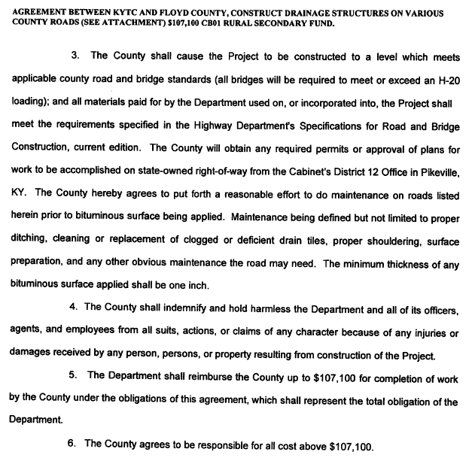
Bridge Standards

Slide 4
Bridge Plans

Slide 5
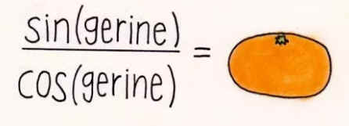
Bridge Standards
County Bridges – H20 Loading
Will carry School Bus
No logging trucks
No Cement Trucks
No Agricultural Trucks
KY Law says 44 tons on any truck is legal on most roads.

Slide 6
Bridge Standards
Simple to Construct
No Deck Finishing Machine Required
No Shear Studs
No Overhang Jacks required
Multiple Truck Loadings
Rolled Steel Beams – H20 and KYHL-93
Side By Side Box Beams – KYHL-93
Multiple Widths
16 ft, 24 ft, & 32 ft
Multiple Skews
0 deg
15deg
30deg
45deg

Slide 7
Bridge Standards
Currently Completed Standards
Existing Concrete Side By Side Box Beams
Steel Superstructure Standards
County Bridge Abutments
State Bridge Abutments (wider shoulder)
Pile End Bents
Piers
Culverts (Utilizing Standard headwalls)

Slide 8
Side by Side Concrete Beams (updated 2011)
Changes made to standards in 2011
Eliminated curb (No crash testing)
Eliminated drains
Updated Design Code and loading
Load distribution (broken tension rods)
Different Strand Size (0.153 to 0.167)
Stronger Concrete
Added Design Rxns & Design Deflections
So you could do construction elevations

Slide 9
Steel Beam Standards
Similar Design Criteria as SBS box beams
4 ft beam spacing
Simplified distribution
Designs done in MDX and independently checked by Joseph Van Zee
with Mathcad program.

Slide 10
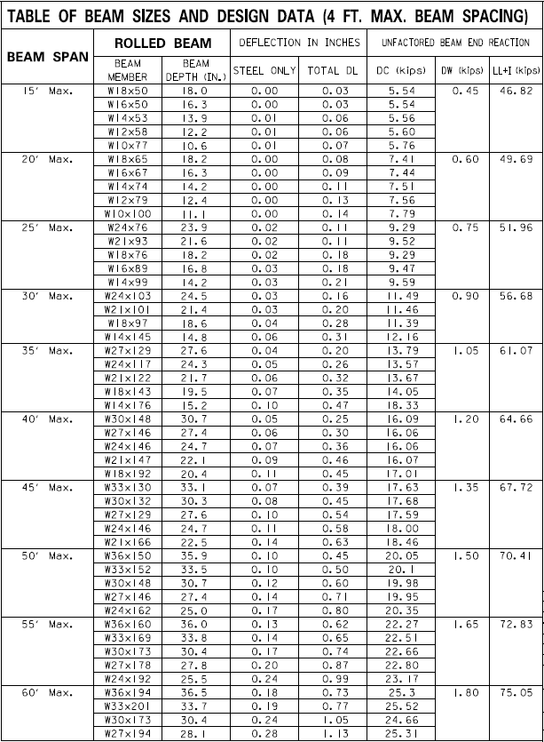
H20 / KYHL-93

Slide 11
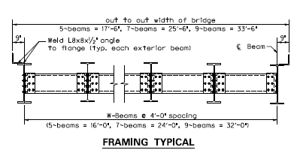
Framing Plan

Slide 12
Slab Design and Details

Slide 13
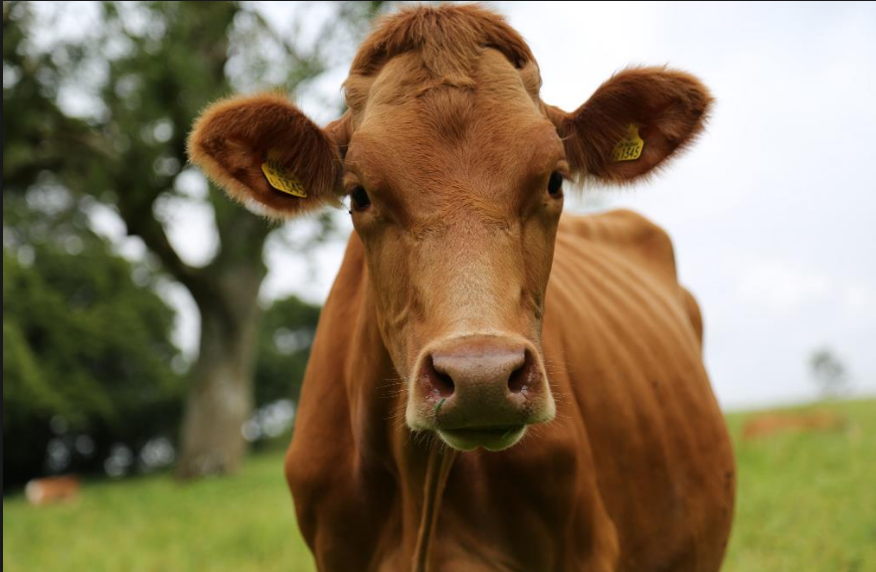
Joke
What do you get when you take a bovine and divide its circumference by its diameter?…

Slide 14
County Bridge Replacement Program Drawings
1990 to 1994 → Something close to 868 bridges went to bid.
Many of these were standard drawing bridges.

Slide 15
1990s Standard Abutments
12 standard abutment Sheets
4 different skews with 3 different out to out superstructure widths
0, 15, 30, and 45 degree skews and 16’, 24’, and 32’ widths.
Designed for use with Std. Dwg. SBS box beams.

Slide 16
Art of Simplicity
Have you ever seen someone detail a breastwall abutment with 18 bar marks?
Walls were designed up to 20’ tall. (at seat level)
Actual design height ~ 24’

Slide 17
Old Abutment Standard Design
We don’t know much about the design.
No notes about design assumptions.
All we have is the drawings.

Slide 18
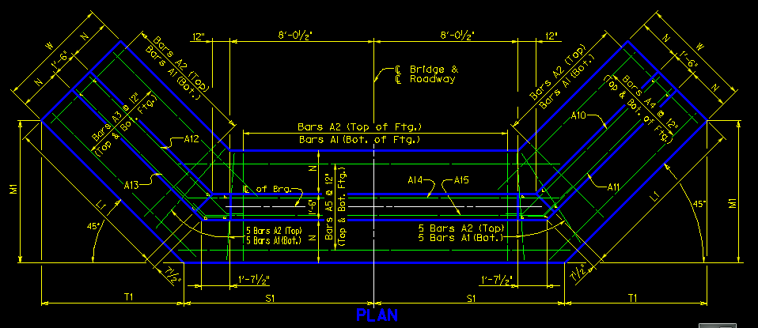
Plan View of 0016
All walls were 18” thick. Toe and Heel dimensions same on all 3 sections.
Shoulder break was 1’-9” from Guardrail face

Slide 19
Elevation View of 0016
Wing drop limited by superstructure height.
Reinforcement above bearing area limited to vertical bars of maximum length. (variable embedment)

Slide 20
Puns
We stole a lot of good stuff from the old Standards
It’s hard to explains puns to kleptomaniacs because they always take things literally.

Slide 21
New Std. Abutments

Slide 22
Design Considerations for Abutments
New design standards make them a lot beefier.
24” Thick walls vs. 18”.
Maximum Wall Heights Reduced. (We knocked 4’ off)
Shoulder break @ 2’-6” for SBS box beam bridge. (9” more)
Wall lengths calculated with 2:1 slope to top of footings vs. 1.5:1. (much longer)
Calculations depend on Height & Skew (Not Width)
Footing pressures at 8 ksf Service & 10.8 ksf Strength vs. unknown on old standards.
Recommend footings keyed into rock for scour.

Slide 23
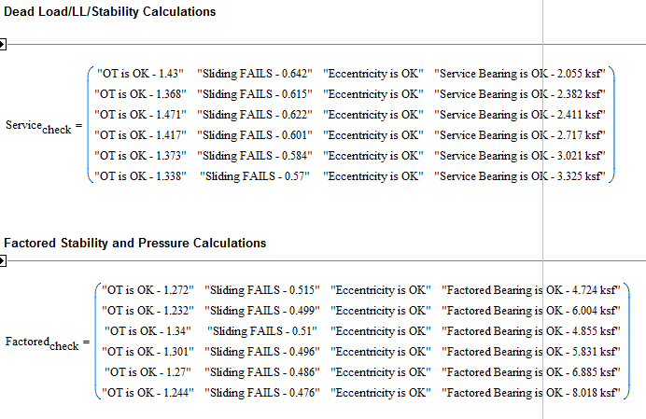
Mathcad Retaining Wall Program
Footings need to be keyed into rock not only for scour.

Slide 24
Program
Wrote a new Mathcad program to calculate all dimensions & quantities for standard abutments.
And automatically fill in the tables for all variable dimensions and quantities. (Using text file output fed back into microstation)
Program inputs include all variables for standard abutment
Height
Footing Width
Wing Lengths
Skew
Roadway Width
Stem Thickness (Breastwall & Wings)
Design Bar size & bar spacing for each of 18 bar marks
Etc. etc…

Slide 25
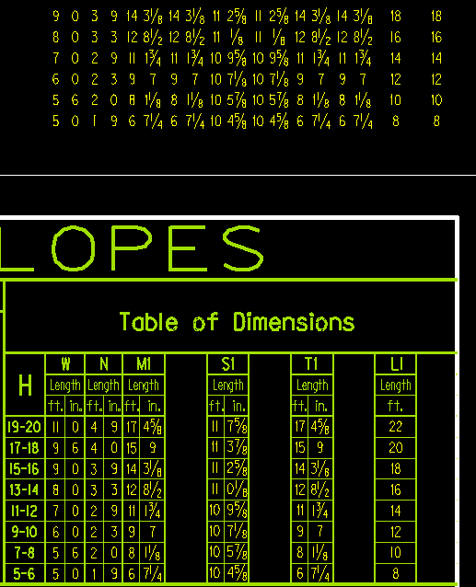
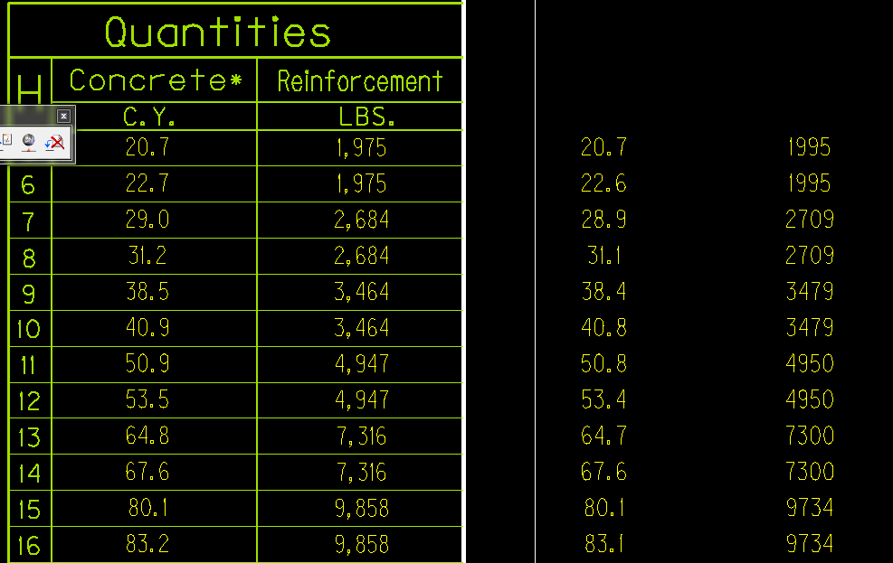
Mathcad Program
Program calibrated against 1990s standards for accuracy.
Identified minor mistakes and inconsistencies in both the old standards and my program.

Slide 26
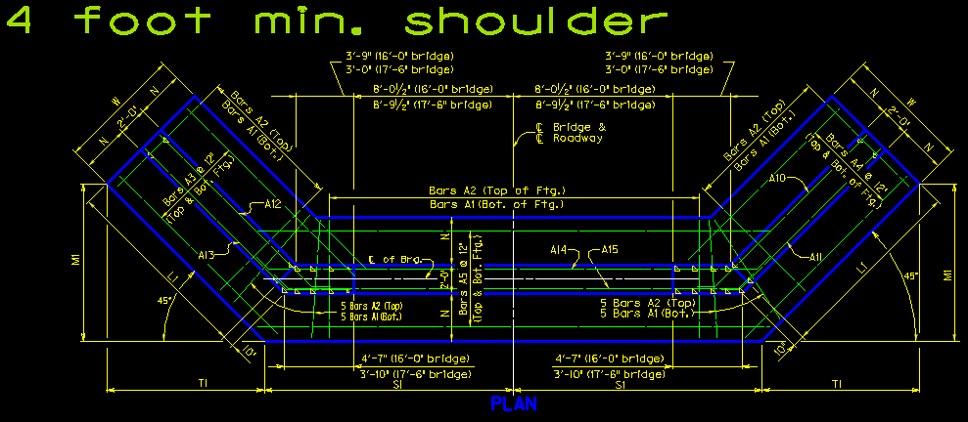
Mathcad Program
It took a month to write the program & run the old 12 sets.
Program makes it extremely simple to produce a new set of standard drawings with different variables.
One day of work to produce set of 12 standard drawings with bigger shoulder.

Slide 27
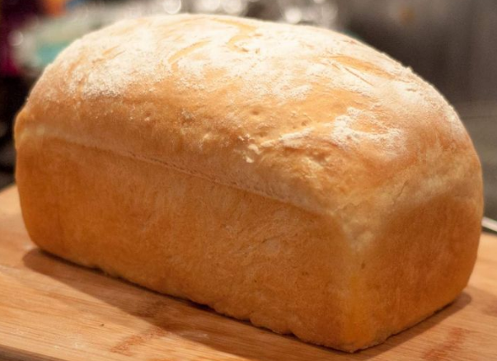
Think Differently

Slide 28
1990s Standard Piers
12 standard drawing Sheets
4 different skews with 3 different out to out superstructure widths
0, 15, 30, and 45 degree skews and 16’, 24’, and 32’ widths.
Designed for use with Std. Dwg. SBS box beams.

Slide 29
1990s Standard Piers
13 total bar marks

Slide 30
New Pier Standard Drawings
We recycled the format, and most of the drawings.
If it ain’t broke don’t fix it.
We needed longer pier caps to accommodate steel alternate.
We reduced maximum pier height to 25’.
Design assumptions laid out in notes.
We don’t know the old design assumptions, but new footings are much larger.
Minimum steel requirements in column controlled all the designs.
Designs checked by Lizabeth Likins, P.E.

Slide 31
Design Assumptions

Slide 32
Program
Wrote a new Mathcad program to calculate all dimensions & quantities for standard piers. (much simpler than abutments)
And automatically fill in the tables for all variable dimensions and quantities. (Using text file output fed back into microstation)
Program inputs include all variables for standard piers
Height
Footing Width & Length
Skew
Cap length, depth, & cap width
Stem Thickness & Length
Design Bar size & bar spacing for each of 11 bar marks

Slide 33
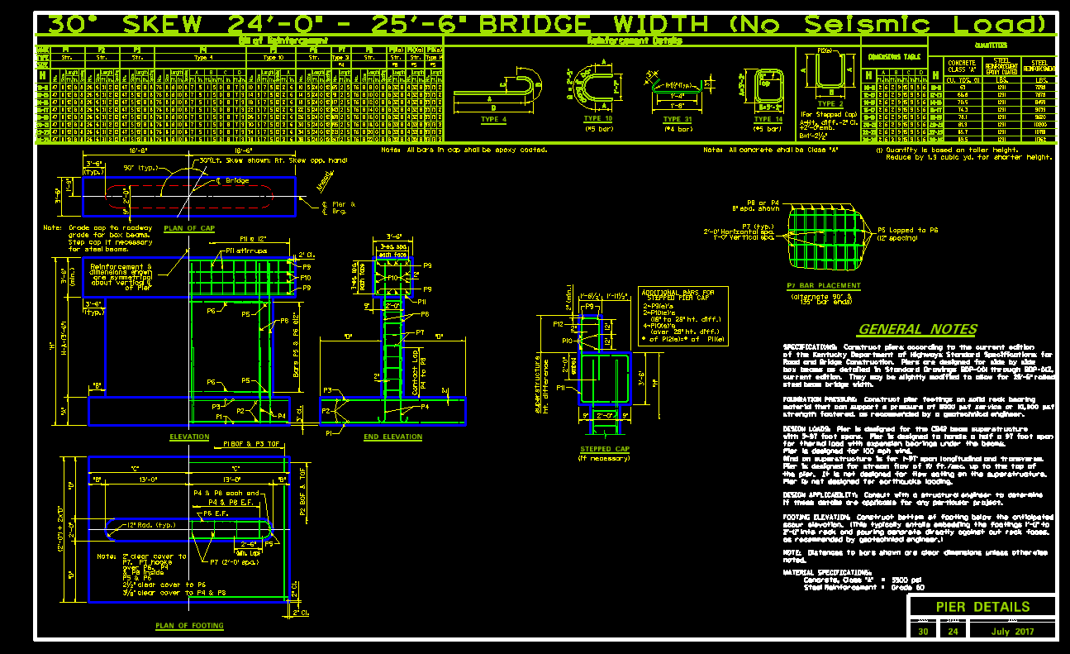
New Drawings

Slide 34
Did you hear about the man who got cooled to absolute zero?
He’s 0K now.

Slide 35
End Bents
New end bents are a major change from the old standards.
Old standards did not have wings.
End bents designed for maximum span of the following:
3 different superstructure heights
H1 – B12, CB12, B17, CB17, B21, or rolled steel up to 16” nominal depth with 8” slab.
H2 – CB21, B27, CB27, B33, or rolled steel beams up to 24” nominal depth with 8” slab.
H3 – CB33, B42, CB42 or rolled steel beams with up to 36” nominal depth with 8” slab.
Piles required are HP12x53 or 16” steel pipes with ½” wall thickness
Piles driven to refusal on rock or use Gates method.

Slide 36
End Bents

Slide 37
Culverts
4x4, 6x4-8, 8x4-8, 10x4-10, 12x4-10, 14x4-10, 16x4-10.
Widths and heights in 2’ increments.
For odd widths/heights, use steel and thicknesses from next size up.
Designed for 0’ fill to 40’. 0-2, 2.01-5, 5-10, 10-15…
Designed for Unyielding according to UKTRP-84-22.
Full bottom Slab
Shear controls the larger fill depths.
Slab thickness can be optimized further at large fills with shear reinforcement
Use the standard precast headwalls in the headwall supplement STD. Dwgs.
207 Culvert Designs total by Eugene Kilgore.

Slide 38
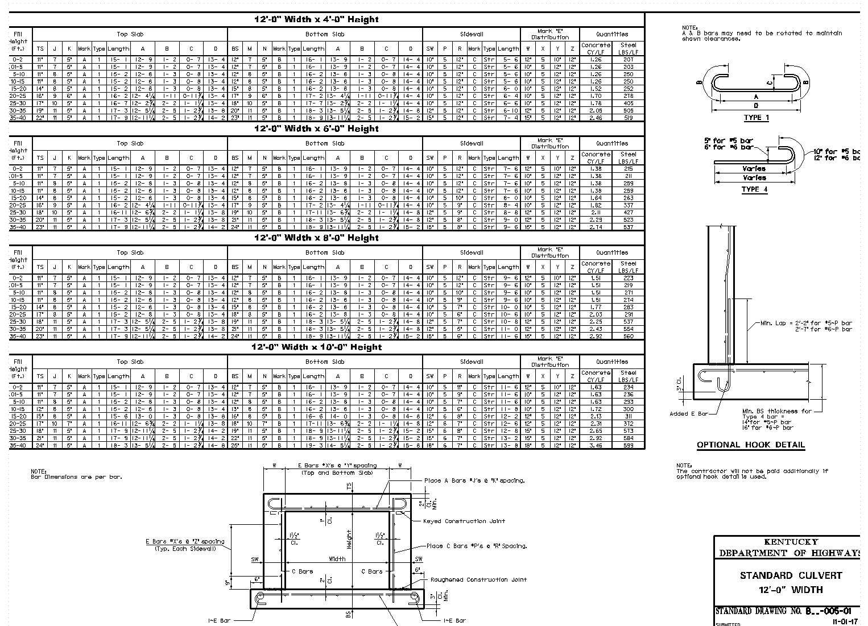
Culverts

Slide 39
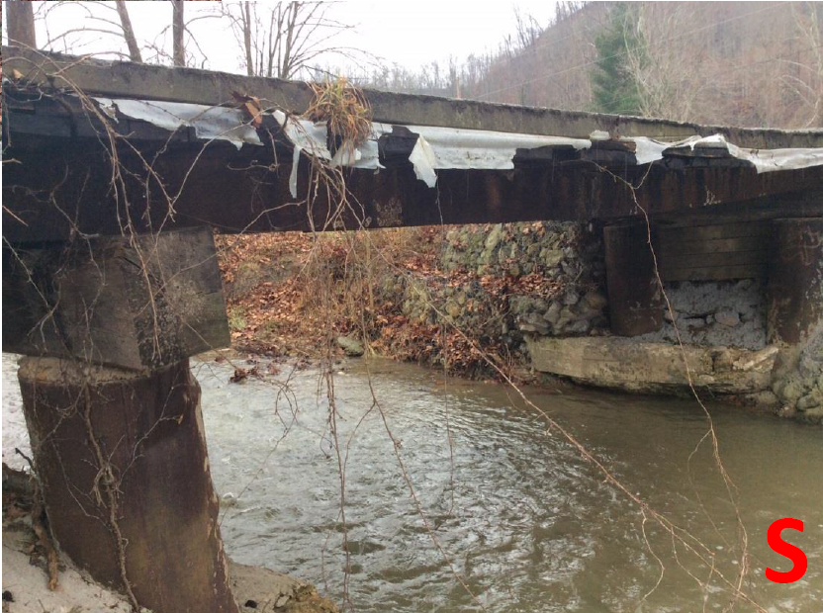
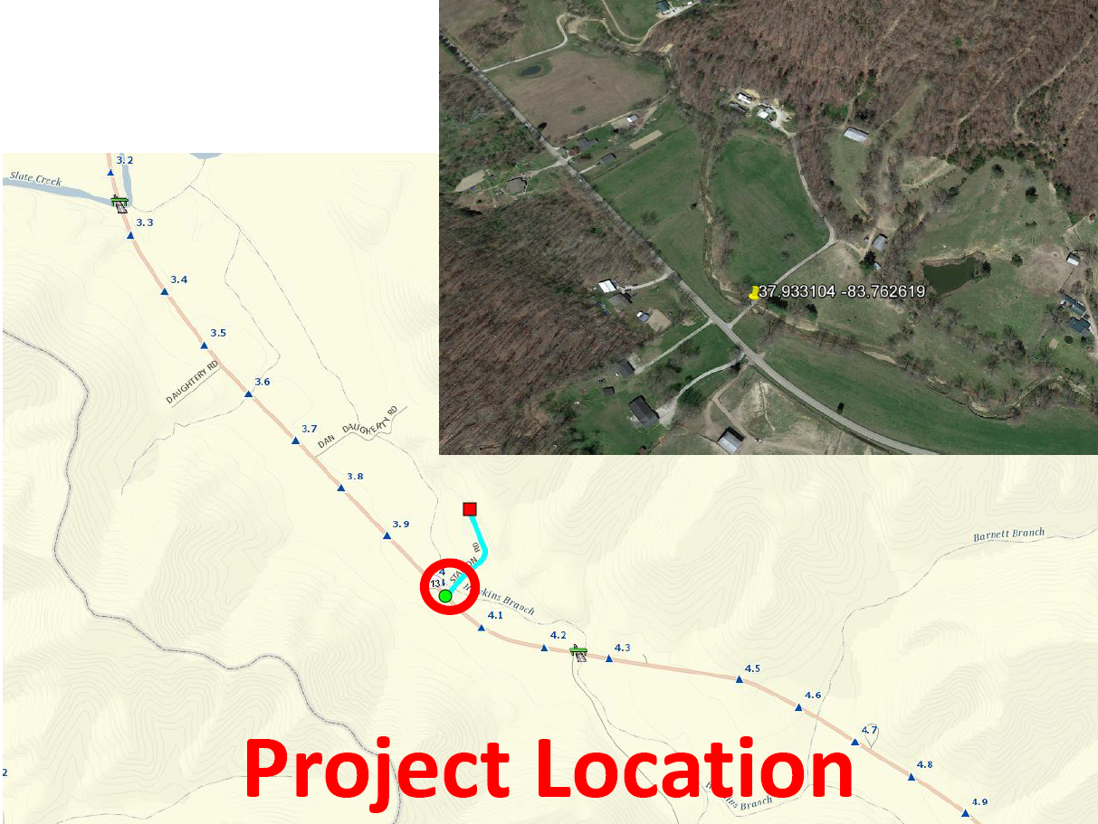
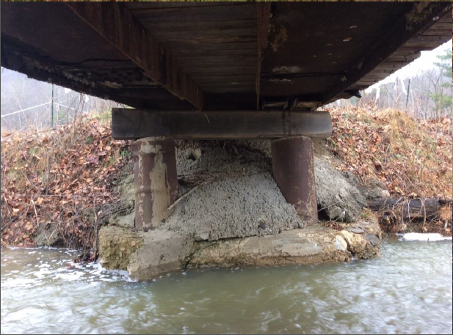
D10 Stallon Road Bridge – Menifee County – CR-1337

Slide 40
D10 Stallon Road Bridge
Bridge Dimensions measured in field
Serves 4 residential homes.
12’ width desired.
Geotech drilled to find rock
D10 came up with multiple options
Plan and profile of each option

Slide 41
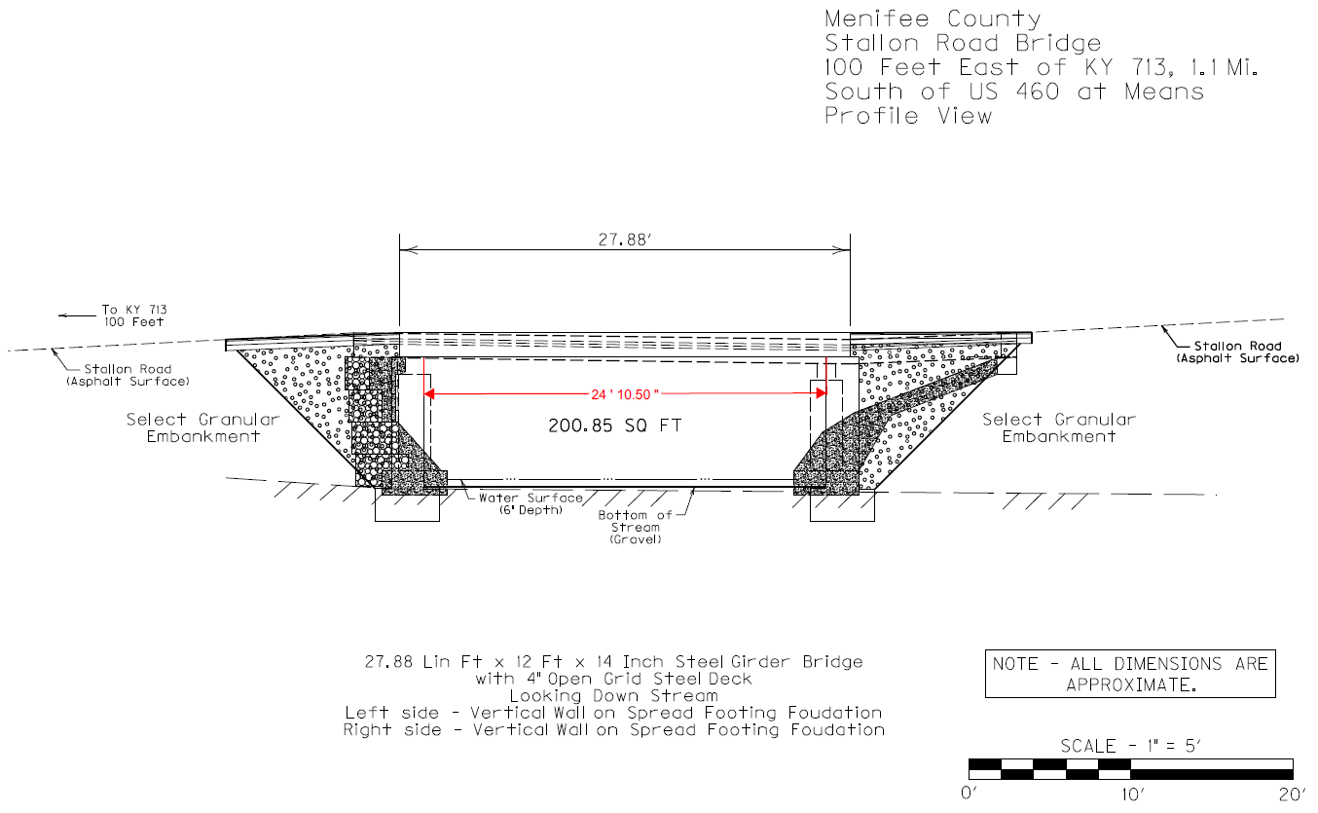
D10 Stallon Road Bridge

Slide 42
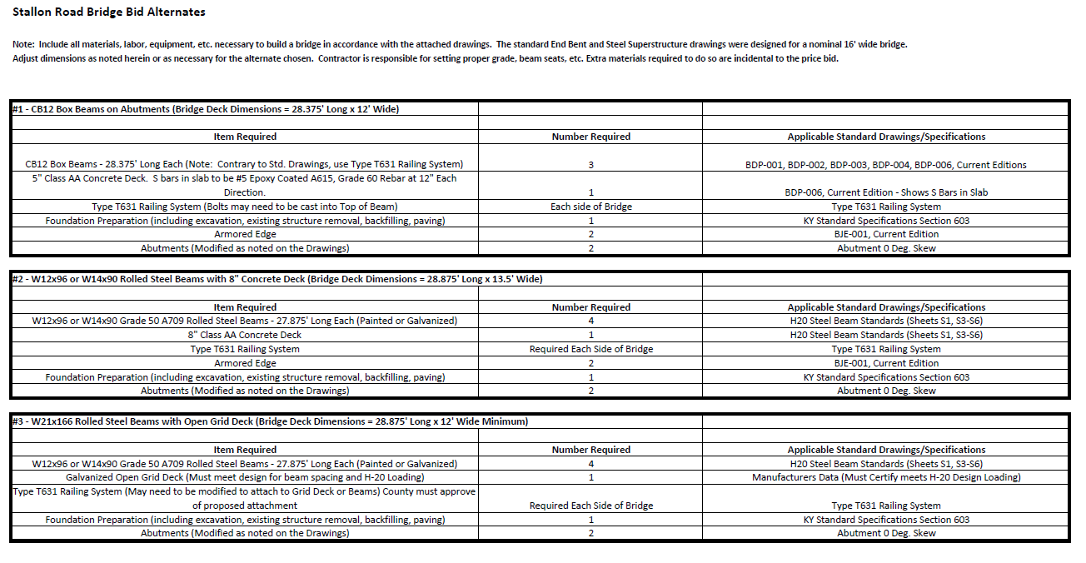
D10 Stallon Road Bridge
Structural Design put together “packet”.
Included all necessary drawings

Slide 43
D10 Stallon Road Bridge
Bid Cost = $59,000 ($155/sq. ft.)

Slide 44
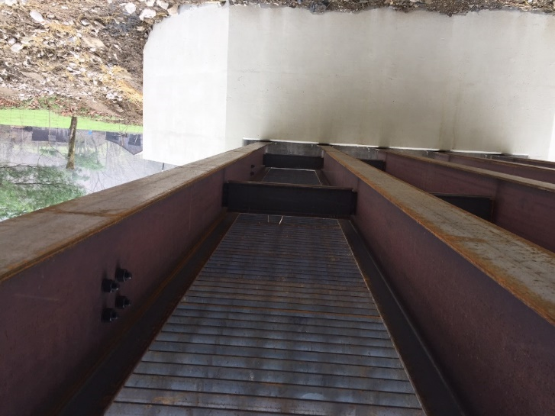
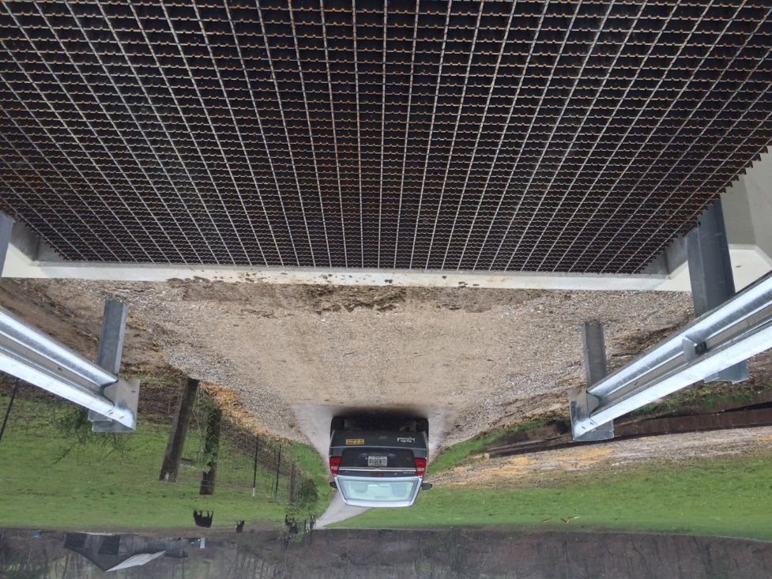
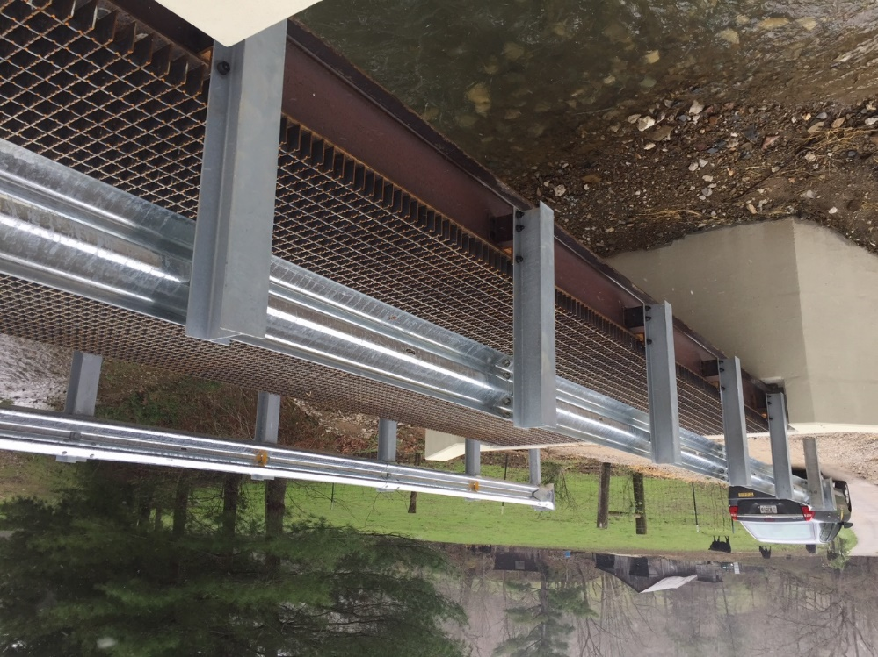
Post
Construction

Slide 45
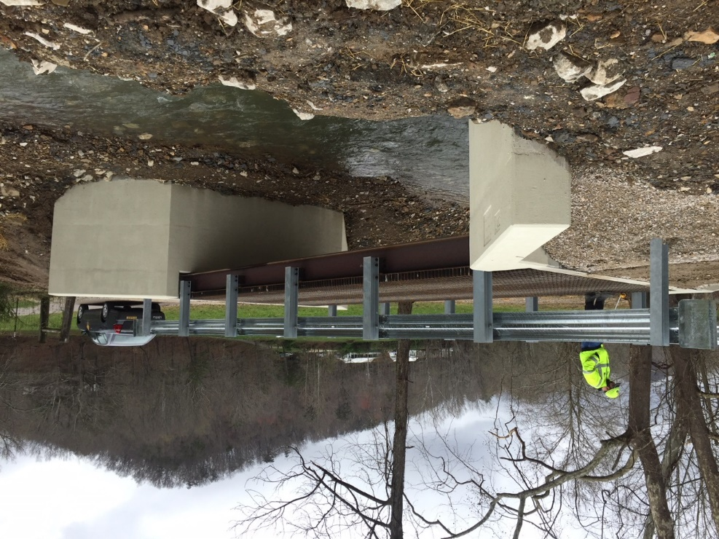
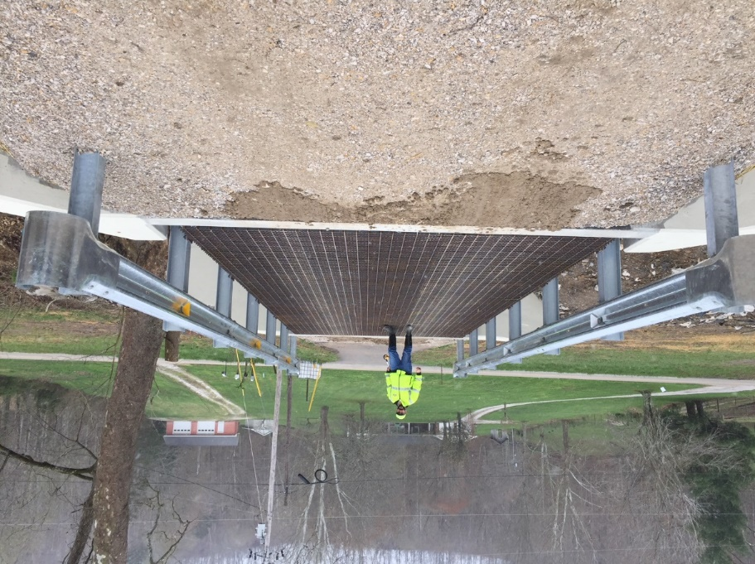
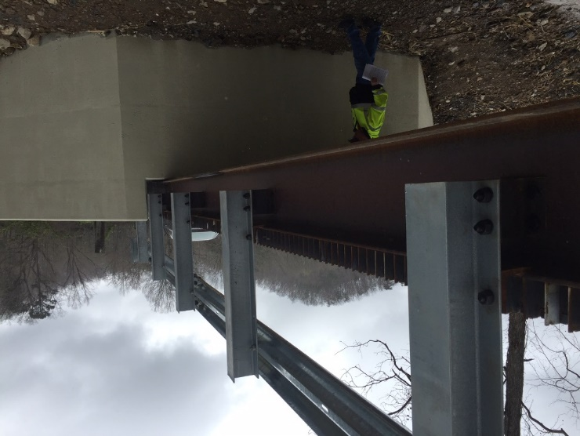
Post
Construction

Slide 46
Structure Cost Data
Bridge and Culvert Cost Data has been posted to our Website.
Need to update for 2018.
Project Managers have been undergoing sticker shock
Future Price Trendline?

Slide 47
Structure Cost Data

Slide 48
Bridge Cost Data
Be very careful with your estimates to Project Managers.
A simple plug into the closeout forms may not be adequate.
Close out forms are last year’s data
Close out forms are average from entire last year
Close out costs do not take into account small or large projects.
Compare Closeout form S.F. cost to costs on website.
Bump up/down unit costs to get something close to website costs.
Based on recent lettings, costs have not leveled out yet and are still moving upwards!

Slide 49
Structurally Deficient/Functionally Obsolete
Functionally obsolete term was based on deck geometry, clearances, approach roadway alignment.
Term was discontinued as of January 2017 with enactment of MAP-21.
Structurally Deficient term defined a structure having a condition rating of 4 or less for deck, superstructure, substructure, or a culvert.
Feds have moved to a performance based system of Good, Fair, or Poor.
Bridge condition is based on lowest rating of NBI for Deck, Superstructure, Substructure, or Culvert.
Lowest rating >=7, Rating is Good.
Lowest rating <=4, Rating is Poor.
Lowest Rating of 5 or 6, Rating is Fair.
Functionally obsolete is no longer an accepted need for a project.

Slide 50
GRS Backfill / Approach Slabs?
Getting lots of questions about when to use GRS Backfill and approach slabs.
The plan is to meet sometime in the near future with Geotech to hash things out and try to put together policies on these items.

Slide 51
Questions????

